Slide 1
Azure SQL Database Business Continuity
Module 3

Slide 3
Learning Units covered in this Module
Lesson 1: Business Continuity Features in Azure SQL Database
Lesson 2: Disaster Recovery Features in Azure SQL Database

Slide 4
Lesson 1: Business Continuity Features in Azure SQL Database

Slide 5

Objectives
After completing this learning, you will be able to:
Understand the various business continuity options within Azure SQL Database.
Understand how to copy and export Azure SQL Databases.
Understand how to perform a point-in-time restore.
Understand how to perform a restore of a deleted database.

Slide 6
Business Continuity Problems
Enabling the application to continuously operate during unplanned and planned disruptive events.
Disruption scenarios in general:
Local hardware or software failures
Data corruption or deletion typically caused by an application bug or human error.
Datacenter outage, possibly caused by a natural disaster.
Upgrade or maintenance errors.
Notes:
Business continuity problem - Enabling the application to continuously operate during unplanned and planned disruptive events
Azure SQL Database provides out-of-the box high availability and fault tolerance, which goes a long way in ensuring business continuity and disaster recovery. Additionally, there are other configurable options that can be utilized to achieve high availability/disaster recovery across multiple regions.

Slide 7
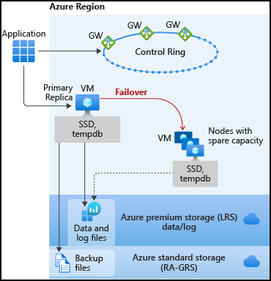
Basic, Standard, and General-Purpose service tier availability
Remote storage configurations are used for Basic, Standard or General-Purpose tiers
The Basic, Standard, and General-Purpose service tiers leverage the standard availability architecture for both serverless and provisioned compute.
Notes:
https://docs.microsoft.com/en-us/azure/sql-database/sql-database-high-availability
Standard availability refers to 99.99% SLA that is applied in Standard/Basic/General Purpose tiers. Availability is achieved by separation of compute and storage layers. In the standard availability model we have two layers:
A stateless compute layer that is running the sqlserver.exe process and contains only transient and cached data (for example – plan cache, buffer pool, column store pool). This stateless SQL Server node is operated by Azure Service Fabric that initializes process, controls health of the node, and performs failover to another place if necessary.
A stateful data layer with database files (.mdf/.ldf) that are stored in Azure Premium Storage Disks. Azure Storage guarantees that there will be no data loss of any record that is placed in any database file. Azure Storage has built-in data availability/redundancy that ensures that every record in log file or page in data file will be preserved even if SQL Server process crashes.
Whenever database engine or operating system is upgraded, or if some critical issue is detected in Sql Server process, Azure Service Fabric will move the stateless SQL Server process to another stateless compute node. Data in Azure Storage layer is not affected, and data/log files are attached to newly initialized SQL Server process. Expected failover time can be measured in seconds. This process guarantees 99.99% availability, but it might have some performance impacts on heavy workload that are running due to transition time and the fact the new SQL Server node starts with cold cache.

Slide 8
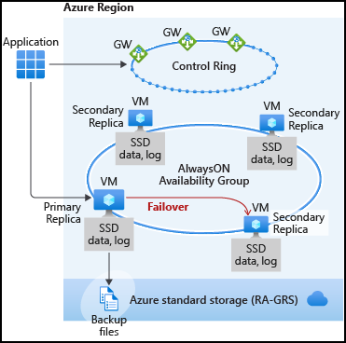
Premium and Business Critical service tier availability
High availability is achieved by replicating both compute and storage to additional nodes.
High availability is implemented using a technology like SQL Server Always On Availability Groups.
The cluster includes a single primary replica for read-write workloads, and up to three secondary replicas (compute and storage) containing copies of data.
The failover is initiated by the Azure Service Fabric.
As an extra benefit, the premium availability model includes Read Scale-Out feature.
Notes:
Premium availability is enabled in Premium tier of Azure SQL Database and it is designed for intensive workloads that cannot tolerate any performance impact due to the ongoing maintenance operations.
In the premium model, Azure SQL database integrates compute and storage on the single node. Both the SQL Server Database Engine process and underlying mdf/ldf files are placed on the same node with locally attached SSD storage providing low latency to your workload.
High availability is implemented using standard Always On Availability Groups. Every database is a cluster of database nodes with one primary database that is accessible for customer workload, and a few secondary processes containing copies of data. The primary node constantly pushes the changes to secondary nodes in order to ensure that the data is available on secondary replicas if the primary node crashes for any reason. Failover is handled by the SQL Server Database Engine – one secondary replica becomes the primary node and a new secondary replica is created to ensure enough nodes in the cluster. The workload is automatically redirected to the new primary node. Failover time is measured in milliseconds and the new primary instance is immediately ready to continue serving requests.

Slide 9
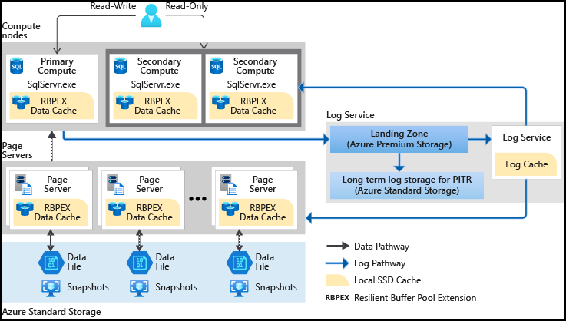
Hyperscale High Availability
In Hyperscale databases, data resiliency is provided at the storage level. When the compute replica is down, a new replica is created automatically with no data loss.
However, if there’s only one replica, it may take some time to build the local cache in the new replica after failover. During the cache rebuild phase, the database fetches data directly from the page servers, resulting in higher storage latency and degraded query performance.
For mission-critical apps that require high availability with minimal failover impact, you should provision at least 2 compute replicas including the primary compute replica. That way there is a hot-standby replica available that serves as a failover target.
Notes:
For high availability, do I need to provision additional compute replicas
In Hyperscale databases, data resiliency is provided at the storage level. You only need one replica to provide resiliency. When the compute replica is down, a new replica is created automatically with no data loss.
However, if there’s only one replica, it may take some time to build the local cache in the new replica after failover. During the cache rebuild phase, the database fetches data directly from the page servers, resulting in higher storage latency and degraded query performance.
For mission-critical apps that require high availability with minimal failover impact, you should provision at least 2 compute replicas including the primary compute replica. This is the default configuration. That way there is a hot-standby replica available that serves as a failover target.

Slide 10
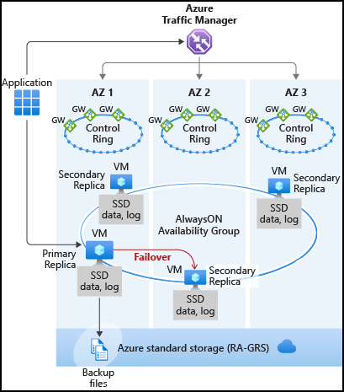
Zone redundant configuration
Zone redundant configurations are currently only supported in the Premium or Business Critical tiers
By default, the cluster of nodes for the premium availability model is created in the same datacenter.
SQL Database can place different replicas of the Business-Critical database to different availability zones in the same region.
The routing is controlled by Azure Traffic Manager (ATM).
The zone redundant databases have replicas in different datacenters with some distance between them, the increased network latency may impact the performance.
Notes:
By default, the quorum-set replicas for the local storage configurations are created in the same datacenter. With the introduction of Azure Availability Zones, you have the ability to place the different replicas in the quorum-sets to different availability zones in the same region. To eliminate a single point of failure, the control ring is also duplicated across multiple zones as three gateway rings (GW). The routing to a specific gateway ring is controlled by Azure Traffic Manager (ATM). Because the zone redundant configuration does not create additional database redundancy, the use of Availability Zones in the Premium or Business Critical service tiers is available at no extra cost. By selecting a zone redundant database, you can make your Premium or Business Critical databases resilient to a much larger set of failures, including catastrophic datacenter outages, without any changes of the application logic. You can also convert any existing Premium or Business Critical databases or pools to the zone redundant configuration.
Because the zone redundant quorum-set has replicas in different datacenters with some distance between them, the increased network latency may increase the commit time and thus impact the performance of some OLTP workloads. You can always return to the single-zone configuration by disabling the zone redundancy setting. This process is a size of data operation and is similar to the regular service level objective (SLO) update. At the end of the process, the database or pool is migrated from a zone redundant ring to a single zone ring or vice versa.

Slide 11
Automatic Backups
Uses SQL Server technology to create full, differential, and transaction log backups.
Transaction log backups, with full and differential backups, allow you to restore a database to a specific point-in-time to the same server that hosts the database.
When you restore a database, the service figures out which full, differential, and transaction log backups need to be restored.
Notes:
SQL Database supports self-service for point-in-time restore (PITR) by automatically creating full backup, differential backups, and transaction log backups. Full database backups are created weekly, differential database backups are generally created every 12 hours, and transaction log backups are generally created every 5 - 10 minutes, with the frequency based on the performance level and amount of database activity. The first full backup is scheduled immediately after a database is created. It usually completes within 30 minutes, but it can take longer when the database is of a significant size. For example, the initial backup can take longer on a restored database or a database copy. After the first full backup, all further backups are scheduled automatically and managed silently in the background. The exact timing of all database backups is determined by the SQL Database service as it balances the overall system workload.

Slide 12
Azure SQL Database Backup Retention Periods
All Azure SQL databases (single, pooled, and managed instance databases) have a default backup retention period of seven days.
You can change backup retention period up to 35 days.
If you delete a database, SQL Database will keep the backups in the same way it would for an online database.
If you need to keep the backups for longer than the maximum retention period, you can modify the backup properties to add one or more long-term retention periods to your database.
The point-in-time backups are geo-redundant and protected by Azure Storage cross-regional replication.
How long are backups kept.
Notes:
Azure SQL Database service provides automatic backup capabilities for all databases. The retention of these backups is dependent on the service tier the database is running in. For example, for a database running in the basic service tier, the backups are retained for seven days, while for standard and premium service tiers, the retention is 35 days. The database can be restored to any point in time within the retention period from the backups. These backups are stored locally and on a geo-redundant storage account with read access to the geo-copy.

Slide 13
How to change backup retention period
You can change the default PITR backup retention period using the Azure portal, PowerShell, or the REST API.
The following examples illustrate how to change PITR retention to 28 days.
PowerShell
Set-AzSqlDatabaseBackupShortTermRetentionPolicy -ResourceGroupName resourceGroup -ServerName testserver -DatabaseName testDatabase -RetentionDays 28
REST
PUT https://management.azure.com/subscriptions/00000000-1111-2222-3333-444444444444/resourceGroups/resourceGroup/providers/Microsoft.Sql/servers/testserver/databases/testDatabase/backupShortTermRetentionPolicies/default?api-version=2017-10-01-preview
The supported values are: 7, 14, 21, 28 or 35 days.
Notes:
You can change the default retention using REST API or PowerShell. The supported values are: 7, 14, 21, 28 or 35 days. The examples illustrate how to change PITR retention to 28 days.

Slide 14
Extending the Retention Period
You can configure a single or a pooled database with a long-term backup retention policy (LTR) to automatically retain the database backups in separate Azure Blob storage containers for up to 10 years.
You can then recover a database using these backups using the Azure portal or PowerShell.
Deleting LTR backup is non-reversible. To delete an LTR backup after the server has been deleted you must have Subscription scope permission.
Notes:
https://docs.microsoft.com/en-us/azure/sql-database/sql-database-long-term-backup-retention-configure

Slide 15
How SQL Database long-term retention works
Weekly backup retention (W)
Monthly backup retention (M)
Yearly backup retention (Y)
Week of year (WeekOfYear)
Long-term backup retention leverages the automatic SQL Database backups created to enable point-time restore (PITR).
Specify for each SQL database how frequently you need to copy the backups to the long-term storage.
W=0, M=0, Y=5, WeekOfYear=3
The 3rd full backup of each year will be kept for 5 years.
W=0, M=3, Y=0
The first full backup of each month will be kept for 3 months.
W=12, M=0, Y=0
Each weekly full backup will be kept for 12 weeks.
Notes:
https://docs.microsoft.com/en-us/azure/sql-database/sql-database-long-term-retention
Long-term backup retention leverages the automatic SQL Database backups created to enable point-time restore (PITR). You can configure a long term retention policy for each SQL database and specify how frequently you need to copy the backups to the long-term storage. To enable that flexibility you can define the policy using a combination of four parameters: weekly backup retention (W), monthly backup retention (M), yearly backup retention (Y) and week of year (WeekOfYear). If you specify W, one backup every week will be copied to the long-term storage. If you specify M, one backup during the first week of each month will be copied to the long-term storage. If you specify Y, one backup during the week specified by WeekOfYear will be copied to the long-term storage. Each backup will be kept in the long-term storage for the period specified by these parameters.
Examples:
W=0, M=0, Y=5, WeekOfYear=3
The 3rd full backup of each year will be kept for 5 years.
W=0, M=3, Y=0
The first full backup of each month will be kept for 3 months.
W=12, M=0, Y=0
Each weekly full backup will be kept for 12 weeks.
W=6, M=12, Y=10, WeekOfYear=16
Each weekly full backup will be kept for 6 weeks. Except first full backup of each month, which will be kept for 12 months. Except the full backup taken on 16th week of year, which will be kept for 10 years.

Slide 16
Hyperscale Backup & Restore
Snapshots
Log Service
Page Server 1
Log Landing Zone
Page Server 2
Page Server 3
Long term long storage
Start LSN of oldest transaction (latest snapshot with ADR)
among all snapshots
Point in time
Point in time
Primary Computer
Page Servers
Recovery
Backup has no impact to apps.
Parallelized copy (metadata).
Constant time PITR.
Accelerated database recovery.
Log Service
Log Landing Zone
Azure Storage
Long term long storage
Notes:
Backups are file-snapshot based and therefore they are nearly instantaneous. Storage and compute separation enable pushing down the backup/restore operation to the storage layer to reduce the processing burden on the primary compute node. As a result, the backup of a large database does not impact the performance of the primary compute node. Similarly, restores are done by copying the file snapshot and as such are not a size of data operation. For restores within the same storage account, the restore operation is fast.

Slide 17

Demonstration
Configure the long-term retention and view backups in long-term retention.
Notes:
M03L01Demo01
Demo requirements
- The salesdb should be available which has been created during module 1
In the Azure portal, select your Logical SQL server and then click Manage Backups.
On the Configure policies tab, select the database on which you want to set or modify long-term backup retention policies. Make sure that you select the checkbox next to the database! Make sure that your database is Standard Tier because at the time of building this deck I received an error on basic that it’s not supported. LTR is supported/available for basic tier; to avoid the error message, make sure the Point in time recovery setting at the top of the blade is ‘Keep current settings’, because basic doesn't let you modify the PiTR setting
Click the Configure retention button
In the Configure policies pane, select if you want to retain weekly, monthly or yearly backups and specify the retention period for each
When complete, click Apply.
Show the Available backup tab, but of course nothing will appear here yet.

Slide 18
Copy & Export
Copy
Copies an Azure SQL Database to another DB on same or different Server.
Essentially Creates a snapshot.
Export
Creates BACPAC.
Use Portal, SSMS, PowerShell or SQLPackage Utility.
Neither of these were really designed for ongoing backup operations.
Notes:
SQL Database Copy – is designed to make a transaction-consistent copy of your database leveraging the built in backup retention policy. It first makes a copy of the tail of the transaction log, and then uses this tail plus the full, differential, and log backups retained behind the scenes in Azure SQL Database. All this is done without interrupting the log chain of the current database retention plan (a common problem with preemptive full backups in on premises databases).
SQL Database Export – is designed to export a copy of your database to a .bacpac file which is an encapsulated version of the databases schema and data. While not truly a backup file like a .bak file in a traditional SQL database, it does contain everything you need to reconstitute your database in the event of an emergency.
SQL Database Export is not transitionally consistent. Therefore, it is strongly recommended that you have a database that is not being actively used while you take the copy. Hence I would recommend starting with database copy, then export, and ultimately drop the copied database.
SQL Database Copy creates a copy of your database. Therefore, if you have a 50 GB P1 database after the operation you’ll have two 50GB P1 databases, and consequently double the cost of hosting the database. Each time you run this operation you’re increasing your cost, and each database gets its own retention schedule which is unnecessary. Using the bacpac approach you keep the database copy around for a small amount of time and keep your costs low. You also get a choice whether you want this retention in Azure Storage which is much cheaper than Azure SQL to use or to take the bacpac out of Azure and into your own data center.

Slide 19
Point In Time Restore
The database can be restored to any service tier or performance level
Creates a new database in the same logical server.
Database Replacement
Rename the original database and then give the restored database the original name using the ALTER DATABASE command in T-SQL.
Data Recovery
Write and execute the necessary data recovery scripts to extract data from the restored database to the original database.
DB1_Backup2
Azure storage
DB1_Backup1
Azure SQL Database Backups
DB1
DB1_Backup3
Azure storage
DB1_GUID
Geo-Replicated Backups
Notes:
Animation
Step 1 – We see the DB being backed up to Azure Store
Step 2 – We see an asynchronous process making 2 more copies of the backup (This is an Azure storage function and not an Azure SQL DB function)
Step 3 – We see the DB restored back to the same server, but it now has a GUID in the name
-------------------------------------------------------------------------------------------------------------------------
The database can be restored to any service tier or performance level, and as a single database or into an elastic pool. Ensure you have sufficient resources on the logical server or in the elastic pool to which you are restoring the database. Once complete, the restored database is a normal, fully accessible, online database. The restored database is charged at normal rates based on its service tier and performance level. You do not incur charges until the database restore is complete.
You generally restore a database to an earlier point for recovery purposes. When doing so, you can treat the restored database as a replacement for the original database or use it to retrieve data from and then update the original database.
Database replacement: If the restored database is intended as a replacement for the original database, you should verify the performance level and/or service tier are appropriate and scale the database if necessary. You can rename the original database and then give the restored database the original name using the ALTER DATABASE command in T-SQL.
Data recovery: If you plan to retrieve data from the restored database to recover from a user or application error, you need to write and execute the necessary data recovery scripts to extract data from the restored database to the original database. Although the restore operation may take a long time to complete, the restoring database is visible in the database list throughout the restore process. If you delete the database during the restore, the restore operation is canceled and you are not charged for the database that did not complete the restore.

Slide 20
Recover an Azure SQL database by using automated database backups
By default, Azure SQL Database backups are stored in geo-replicated blob storage (RA-GRS storage type).
The following options are available for database recovery by using automated database backups. You can:
Create a new database on the same SQL Database server, recovered to a specified point in time within the retention period.
Create a database on the same SQL Database server, recovered to the deletion time for a deleted database.
Create a new database on any SQL Database server in the same region, recovered to the point of the most recent backups.
Create a new database on any SQL Database server in any other region, recovered to the point of the most recent replicated backups.
If you configured backup long-term retention, you could also create a new database from any long-term retention backup on any SQL Database server.
Notes:
By default, Azure SQL Database backups are stored in geo-replicated blob storage (RA-GRS storage type). The following options are available for database recovery by using automated database backups. You can:
Create a new database on the same SQL Database server, recovered to a specified point in time within the retention period.
Create a database on the same SQL Database server, recovered to the deletion time for a deleted database.
Create a new database on any SQL Database server in the same region, recovered to the point of the most recent backups.
Create a new database on any SQL Database server in any other region, recovered to the point of the most recent replicated backups.
If you configured backup long-term retention, you can also create a new database from any long-term retention backup on any SQL Database server.

Slide 21
Restore Deleted Database
Backups retained for 7/35/35 days
Recovery after accidental database deletion:
Now
Time
-7 days
Restores the database to the point of deletion. (earlier backups are deleted).
Creates a new database on the server used by the original database.
Self-service restore to point of deletion
You can choose to failover to the restored database or use scripts to recover data.
DB1’
DB1’
Notes:
If you delete a database, SQL Database keeps the backups in the same way it would for an online database. For example, suppose you delete a Basic database that has a retention period of seven days. A backup that is four days old is saved for three more days.
After downgrading to a lower performance tier, the restore point’s retention period is immediately truncated to the retention period of the performance tier of the current database.
Database replacement: If the restored database is intended as a replacement for the original database, you should verify the performance level and/or service tier are appropriate and scale the database if necessary. You can rename the original database and then give the restored database the original name using the ALTER DATABASE command in T-SQL.
If you plan to retrieve data from the restored database to recover from a user or application error, you will separately need to write and execute whatever data recovery scripts you need to extract data from the restored database to the original database.

Slide 22
Factors Affecting Recovery Time
Size of the database.
Performance level of the database.
The number of transaction logs involved.
The network bandwidth if the restore is to a different region.
Number of concurrent restore requests.
Notes:
The recovery time to restore a database using automated database backups is impacted by several factors:
The size of the database.
The compute size of the database.
The number of transaction logs involved.
The amount of activity that needs to be replayed to recover to the restore point.
The network bandwidth if the restore is to a different region.
The number of concurrent restore requests being processed in the target region.
For a very large and/or active database, the restore may take several hours. If there is prolonged outage in a region, it is possible that there are large numbers of geo-restore requests being processed by other regions. When there are many requests, the recovery time may increase for databases in that region. Most database restores complete within 12 hours.
For a single subscription, there are some limitations on number of concurrent restore requests (including point in time restore, geo restore and restore from long-term retention backup) being submitted and proceeded:
Max # of concurrent requests being processed Max # of concurrent requests being submitted
Single database (per subscription) 10 60
Elastic pool (per pool) 4 200

Slide 23
Demonstration
Point in Time Restore
Perform a point in time restore of a database.
Notes:
M03L01Demo02
Demo Requirements
The salesdb that you have created in module 1
Steps:
To recover to a point in time using the Azure portal, open the page for your database and click Restore on the toolbar.
Show the new database name and rename if you want
Specify the Restore point
Specify the Target Server. For this demo, just use the same logical server
Specify the Pricing Tier
Click OK and wait until your database is restored.

Slide 24

Point in time restore of an Azure SQL Database
Exercise 1: Perform a point in time restore over the original database.
Exercise 2: Rename old and new databases.
Notes:
M03L01Lab01

Slide 25

Questions?

Slide 26
Knowledge Check
True or false: Daily and weekly backups of Azure SQL databases are automatically uploaded to geo-redundant Azure Storage.
True or false: When performing a point-in-time restore, you can choose to overwrite the source database?
Notes:
Question 1: True or false: Daily and weekly backups of Azure SQL databases are automatically uploaded to geo-redundant Azure Storage.
Answer 1 : True; Daily and weekly backups of Azure SQL databases are automatically uploaded to geo-redundant Azure Storage
Question 2: True or false: When performing a point-in-time restore, you can choose to overwrite the source database.
Answer 2: False; When performing a point-in-time restore, you cannot choose to overwrite the source database.

Slide 27
Lesson 2: Disaster Recovery Features in Azure SQL Database

Slide 28
Objectives
After completing this learning, you will be able to:
Understand the various disaster recovery options within Azure SQL Database

Slide 29
Geo-Restore
Restores last daily backup to any Azure region.
Built on geo-redundant Azure Storage.
No extra cost, no capacity guarantee.
RTO≥24h, RPO=24h
Database URL will change after restore.
Point-in-time restore on a geo-secondary is not currently supported.
Geo- replicated
sabcp01bl21
sabcp01bl21
Azure SQL Database backups
Azure storage
Restore to any Azure region
Notes:
You can restore a SQL database on any server in any Azure region from the most recent geo-replicated full and differential backups. Geo-restore uses a geo-redundant backup as its source and can be used to recover a database even if the database or datacenter is inaccessible due to an outage.
Geo-restore is the default recovery option when your database is unavailable because of an incident in the region where the database is hosted. If a large-scale incident in a region results in unavailability of your database application, you can restore a database from the geo-replicated backups to a server in any other region. There is a delay between when a differential backup is taken and when it is geo-replicated to an Azure blob in a different region. This delay can be up to an hour, so, if a disaster occurs, there can be up to one hour data loss. The following illustration shows restore of the database from the last available backup in another region.
Point-in-time restore on a geo-secondary is not currently supported. Point-in-time restore can be done only on a primary database.
Recovery from backups is the most basic of the disaster recovery solutions available in SQL Database with the longest Recovery Point Objective (RPO) and Estimate Recovery Time (ERT). For solutions using small size databases (e.g. Basic service tier or small size tenant databases in elastic pools), geo-restore is frequently a reasonable DR solution with an ERT of 12 hours. For solutions using large databases and require shorter recovery times, you should consider using Failover groups and active geo-replication. Active geo-replication offers a much lower RPO and ERT as it only requires you initiate a failover to a continuously replicated secondary. For more information on business continuity choices, see Overview of business continuity.

Slide 30
Active Geo-replication
Service levels | Basic, standard, premium Self service
Readable secondaries | Up to 4
Regions available | Any Azure region
Replication | Automatic, asynchronous
Manageability tools | REST API, PowerShell, or Azure Portal
Recovery time objective (RTO) | <1 hour
Recovery point objective | <5 minutes
Failover | On demand
Up to 4 secondaries
Notes:
Active geo-replication is designed as a business continuity solution that allows the application to perform quick disaster recovery in case of a data center scale outage. If geo-replication is enabled, the application can initiate failover to a secondary database in a different Azure region. Up to four secondaries are supported in the same or different regions, and the secondaries can also be used for read-only access queries. The failover must be initiated manually by the application or the user. After failover, the new primary has a different connection end point.
If you are using active geo-replication and for any reason your primary database fails, or simply needs to be taken offline, you can initiate failover to any of your secondary databases. When failover is activated to one of the secondary databases, all other secondaries are automatically linked to the new primary.
Active geo-replication leverages the Always On technology of SQL Server to asynchronously replicate committed transactions on the primary database to a secondary database using snapshot isolation. Auto-failover groups provide the group semantics on top of active geo-replication but the same asynchronous replication mechanism is used. While at any given point, the secondary database might be slightly behind the primary database, the secondary data is guaranteed to never have partial transactions. Cross-region redundancy enables applications to quickly recover from a permanent loss of an entire datacenter or parts of a datacenter caused by natural disasters, catastrophic human errors, or malicious acts.

Slide 31
Active geo-replication capabilities
Asynchronous Replication
Readable secondary databases
Multiple Readable Secondary Replicas
Configurable performance level of the secondary database
User-controlled failover and failback
Keeping credentials and firewall rules in sync
Notes:
The active geo-replication feature provides the following essential capabilities:
Automatic Asynchronous Replication: You can only create a secondary database by adding to an existing database. The secondary can be created in any Azure SQL Database server. Once created, the secondary database is populated with the data copied from the primary database. This process is known as seeding. After secondary database has been created and seeded, updates to the primary database are asynchronously replicated to the secondary database automatically. Asynchronous replication means that transactions are committed on the primary database before they are replicated to the secondary database.
Readable secondary databases: An application can access a secondary database for read-only operations using the same or different security principals used for accessing the primary database. The secondary databases operate in snapshot isolation mode to ensure replication of the updates of the primary (log replay) is not delayed by queries executed on the secondary.
Multiple readable secondaries: Two or more secondary databases increase redundancy and level of protection for the primary database and application. If multiple secondary databases exist, the application remains protected even if one of the secondary databases fails. If there is only one secondary database, and it fails, the application is exposed to higher risk until a new secondary database is created.
Configurable performance level of the secondary database: Both primary and secondary databases are required to have the same service tier. A secondary database can be created with lower performance level (DTUs) than the primary. This option is not recommended for applications with high database write activity because the increased replication lag increases the risk of substantial data loss after a failover. In addition, after failover the application’s performance is impacted until the new primary is upgraded to a higher performance level. The log IO percentage chart on Azure portal provides a good way to estimate the minimal performance level of the secondary that is required to sustain the replication load. For example, if your Primary database is P6 (1000 DTU) and its log IO percent is 50% the secondary needs to be at least P4 (500 DTU). You can also retrieve the log IO data using sys.resource_stats or sys.dm_db_resource_stats database views. For more information on the SQL Database performance levels, see What are SQL Database Service Tiers.
User-controlled failover and failback: A secondary database can explicitly be switched to the primary role at any time by the application or the user. During a real outage the “unplanned” option should be used, which immediately promotes a secondary to be the primary. When the failed primary recovers and is available again, the system automatically marks the recovered primary as a secondary and bring it up-to-date with the new primary. Due to the asynchronous nature of replication, a small amount of data can be lost during unplanned failovers if a primary fails before it replicates the most recent changes to the secondary. When a primary with multiple secondaries fails over, the system automatically reconfigures the replication relationships and links the remaining secondaries to the newly promoted primary without requiring any user intervention. After the outage that caused the failover is mitigated, it may be desirable to return the application to the primary region. To do that, the failover command should be invoked with the “planned” option.
Keeping credentials and firewall rules in sync: We recommend using database firewall rules for geo-replicated databases so these rules can be replicated with the database to ensure all secondary databases have the same firewall rules as the primary. This approach eliminates the need for customers to manually configure and maintain firewall rules on servers hosting both the primary and secondary databases. Similarly, using contained database users for data access ensures both primary and secondary databases always have the same user credentials so during a failover, there is no disruptions due to mismatches with logins and passwords. With the addition of Azure Active Directory, customers can manage user access to both primary and secondary databases and eliminating the need for managing credentials in databases altogether.

Slide 32
Failover groups extend geo-replication
Enable geo-replication for a group of databases within a server.
Automatically or manually failover a group of databases.
Available for all service tiers.
Configure the auto-failover policy that best meets your application needs.
Usage of and listener end-points.
DNS record is automatically updated.
alias
mydb.myserver.windows.database.net
*Currently in private preview - Microsoft Confidential – Shared Under NDA Only
Notes:
Auto-failover groups is an extension of active geo-replication. It is designed to manage the failover of multiple geo-replicated databases simultaneously using an application initiated failover or by delegating failover to be done by the SQL Database service based on a user defined criteria. The latter allows you to automatically recover multiple related databases in a secondary region after a catastrophic failure or other unplanned event that results in full or partial loss of the SQL Database service’s availability in the primary region. Additionally, you can use the readable secondary databases to offload read-only query workloads. Because auto-failover groups involve multiple databases, these databases must be configured on the primary server. Both primary and secondary servers for the databases in the failover group must be in the same subscription. Auto-failover groups support replication of all databases in the group to only one secondary server in a different region.
If you are using auto-failover groups to manage database recovery and any outage that impacts one or several of the databases in the group results in automatic failover. You can configure the auto-failover policy that best meets your application needs, or you can opt out and use manual activation. In addition, auto-failover groups provide read-write and read-only listener end-points that remain unchanged during failovers. Whether you use manual or automatic failover activation, failover switches all secondary databases in the group to primary. After the database failover is completed, the DNS record is automatically updated to redirect the end-points to the new region.

Slide 33
Auto-failover group capabilities
Failover group
Failover group listener
Automatic Failover Policy
Grace Period with Data Loss
Notes:
Auto-failover groups feature provides a powerful abstraction of active geo-replication by supporting group level replication and automatic failover. In addition, it removes the necessity to change the SQL connection string after failover by providing the additional listener end-points.
Failover group: One or many failover groups can be created between two servers in different regions (primary and secondary servers). Each group can include one or several databases that are recovered as a unit in case all or some primary databases become unavailable due to an outage in the primary region.
Primary server: A server that hosts the primary databases in the failover group.
Secondary server: A server that hosts the secondary databases in the failover group. The secondary server cannot be in the same region as the primary server.
Adding databases to failover group: You can put several databases within a server or within an elastic pool into the same failover group. If you add a standalone database to the group, it automatically creates a secondary database using the same edition and performance level. If the primary database is in an elastic pool, the secondary is automatically created in the elastic pool with the same name. If you add a database that already has a secondary database in the secondary server, that geo-replication is inherited by the group.
Failover group read-write listener: A DNS CNAME record formed as <failover-group-name>.database.windows.net that points to the current primary server URL. It allows the read-write SQL applications to transparently reconnect to the primary database when the primary changes after failover.
Failover group read-only listener: A DNS CNAME record formed as <failover-group-name>.secondary.database.windows.net that points to the secondary server’s URL. It allows the read-only SQL applications to transparently connect to the secondary database using the specified load-balancing rules.
Automatic failover policy: By default, the failover group is configured with an automatic failover policy. The system triggers failover after the failure is detected and the grace period has expired. The system must verify that the outage cannot be mitigated by the built-in high availability infrastructure of the SQL Database service due the scale of the impact. If you want to control the failover workflow from the application, you can turn off automatic failover.
Read-only failover policy: By default, the failover of the read-only listener is disabled. It ensures that the performance of the primary is not impacted when the secondary is offline. However, it also means the read-only sessions will not be able to connect until the secondary is recovered. If you cannot tolerate downtime for the readonly sessions and are OK to temporarily use the primary for both read-only and read-write traffic at the expense of the potential performance degradation of the primary, you can enable failover for the read-only listener. In that case the read-only traffic will be automatically redirected to the primary server if the secondary server is not available.
Manual failover: You can initiate failover manually at any time regardless of the automatic failover configuration. If automatic failover policy is not configured, manual failover is required to recover databases in the failover group. You can initiate forced or friendly failover (with full data synchronization). The latter could be used to relocate the active server to the primary region. When failover is completed, the DNS records are automatically updated to ensure connectivity to the correct server.
Grace period with data loss: Because the primary and secondary databases are synchronized using asynchronous replication, the failover may result in data loss. You can customize the automatic failover policy to reflect your application’s tolerance to data loss. By configuring GracePeriodWithDataLossHours, you can control how long the system waits before initiating the failover that is likely to result data loss.

Slide 34
Accelerated Database Recovery (ADR)
A new SQL database engine feature that greatly improves database availability, especially in the presence of long running transactions, by redesigning the SQL database engine recovery process.
The primary benefits of ADR are:
Fast and consistent database recovery.
Instantaneous transaction rollback.
Truncation.
Notes:
Accelerated Database Recovery (ADR) is a new SQL database engine feature that greatly improves database availability, especially in the presence of long running transactions, by redesigning the SQL database engine recovery process. ADR is currently available for single databases and pooled databases in Azure SQL Database, and databases in Azure SQL Data Warehouse (currently in public preview). The primary benefits of ADR are:
Fast and consistent database recovery
With ADR, long running transactions do not impact the overall recovery time, enabling fast and consistent database recovery irrespective of the number of active transactions in the system or their sizes.
Instantaneous transaction rollback
With ADR, transaction rollback is instantaneous, irrespective of the time that the transaction has been active or the number of updates that has performed.
Aggressive log truncation
With ADR, the transaction log is aggressively truncated, even in the presence of active long running transactions, which prevents it from growing out of control.

Slide 35
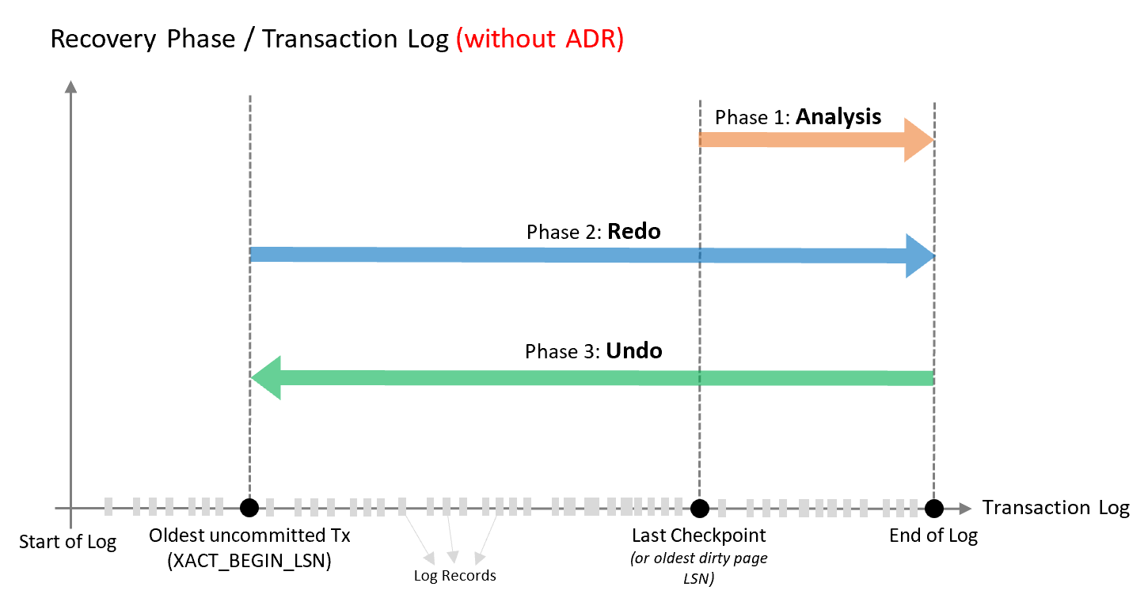
Accelerated Database Recovery – without ADR
Notes:
https://docs.microsoft.com/en-us/azure/sql-database/sql-database-accelerated-database-recovery
ADR provides versioning for the transaction log and allows for almost instantaneous recovery. ADR has a direct impact on failovers to bring databases up quickly despite long running transactions.
Who should consider Accelerated Database Recovery
The following types of customers should consider enabling ADR:
Customers that have workloads with long running transactions.
Customers that have seen cases where active transactions are causing the transaction log to grow significantly.
Customers that have experienced long periods of database unavailability due to SQL Server long running recovery (such as unexpected SQL Server restart or manual transaction rollback).
Analysis phase
Forward scan of the transaction log from the beginning of the last successful checkpoint (or the oldest dirty page LSN) until the end, to determine the state of each transaction at the time SQL Server stopped.
Redo phase
Forward scan of the transaction log from the oldest uncommitted transaction until the end, to bring the database to the state it was at the time of the crash by redoing all committed operations.
Undo phase
For each transaction that was active as of the time of the crash, traverses the log backwards, undoing the operations that this transaction performed.

Slide 36
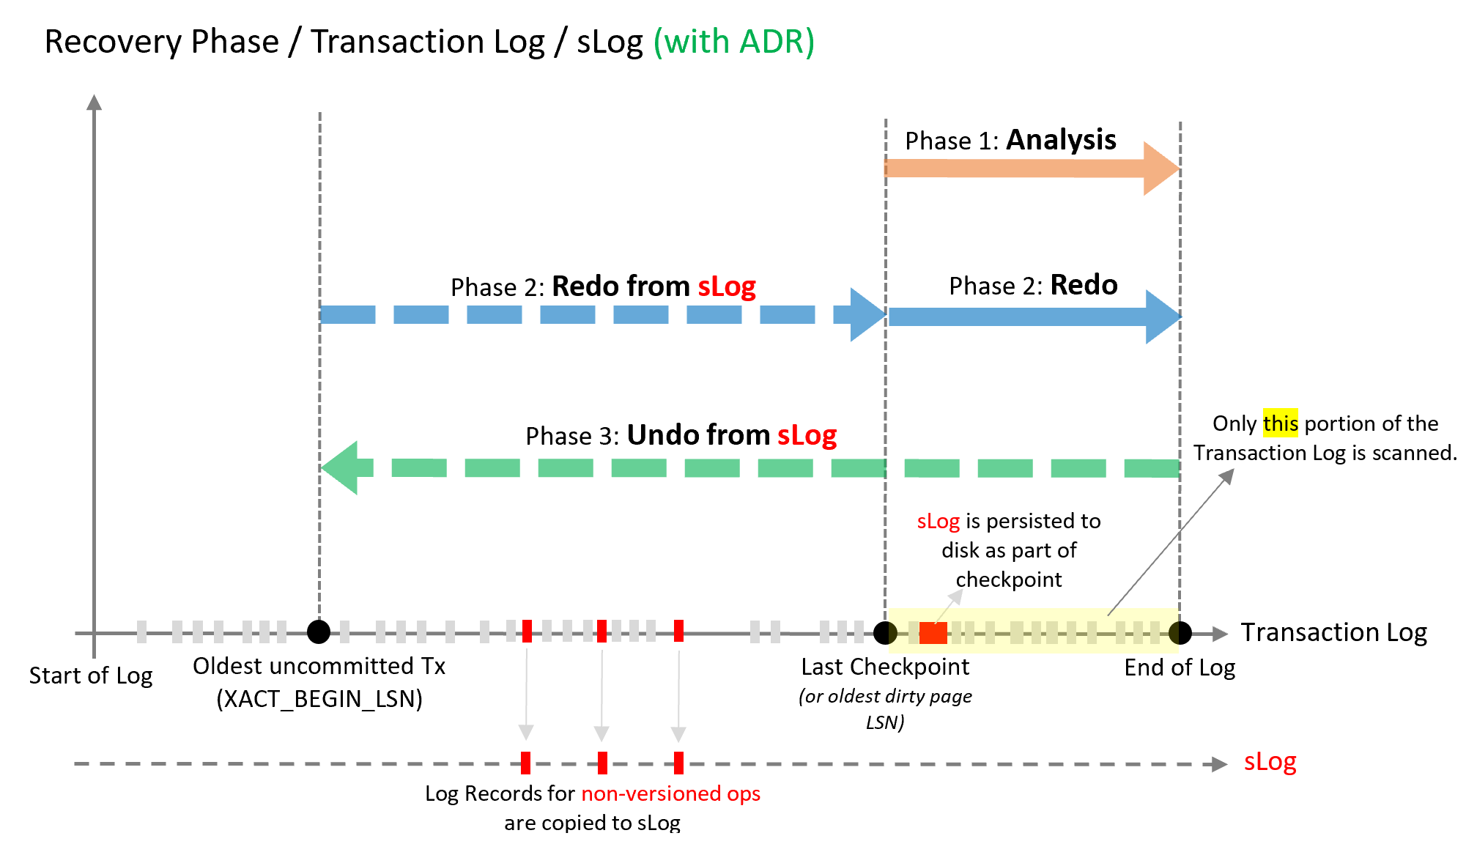
Accelerated Database Recovery – with ADR
Notes:
Analysis phase
The process remains the same as today with the addition of reconstructing sLog and copying log records for non-versioned operations.
Redo phase
Broken into two phases (P)
Phase 1
Redo from sLog (oldest uncommitted transaction up to last checkpoint). Redo is a fast operation as it only needs to process a few records from the sLog.
Phase 2
Redo from Transaction Log starts from last checkpoint (instead of oldest uncommitted transaction)
Undo phase
The Undo phase with ADR completes almost instantaneously by using sLog to undo non-versioned operations and Persisted Version Store (PVS) with Logical Revert to perform row level version-based Undo.

Slide 37
Demonstration
Geo Replication
Setup Geo Replication for an Azure SQL Database.
Notes:
M03L02Demo01
Demo requirements
Make sure that the salesdb is available which was created during module 1
Demo steps:
Open the Azure Portal and go to your database salesdb
Click Geo-Replication. You can see your primary region which is the region where your current database is created. You will see all available target regions
Select a Target Region
In the “Create secondary” ribbon, click Target Server
Create a new server
Specify the server name
Server admin login
Passsword
Do not specify elastic database pools
Keep the suggested pricing tier
Click OK and wait unit the synchronization is OK. The dashed blue line should become a full blue line
During the synchronization, open SSMS and connect to your primary server and execute the following statement to follow the synchronization process
select * from sys.dm_operation_status
10. Once the synchronization is finished, you still have to configure the firewall rules on the target server. Add the Client IP address in the firewall rules of the secondary server
11. Connect with SSMS to the secondary database and make a select statement on one of the tables to demonstrate that the secondary is readable.
12. Also explain that a force failover is possible. Do not failover because the students will have to do this during the labs.

Slide 38
Configure Geo Replication for an Azure SQL Database
Exercise 1: Create a Failover Group.
Exercise 2: Verify the functionality of the secondary.
Exercise 3: Perform a Failover.
Notes:
M03L02Lab01

Slide 39
Questions?

Slide 40
Knowledge Check
True or false: Can you configure both Synchronous and Asynchronous Replication for the replicas in Geo Replication?
True or false: Both primary and secondary databases are required to have the same service tier.
What is the Grace period with data loss on the Failover Group?
Notes:
Question 1: True or false: Can you configure both Synchronous and Asynchronous Replication for the replicas in Geo Replication?
Answer 1 : False - Active Geo-Replication asynchronously replicates committed transactions from a database to up to four copies . No provision to configure it as synchronous,
Question 2: True or false: Both primary and secondary databases are required to have the same service tier?
Answer 2: True - Both primary and secondary databases are required to have the same service tier. The performance level of the database can be changed within the service tier.
Question 3: What is the Grace period with data loss on the Failover Group?
Answer 3: Because the primary and secondary databases are synchronized using asynchronous replication, the failover may result in data loss. You can customize the automatic failover policy to reflect your application’s tolerance to data loss. By configuring GracePeriodWithDataLossHours, you can control how long the system waits before initiating the failover that is likely to result data loss.

Slide 41
Module Summary
Business Continuity
Disaster Recovery

